Slide 1
Supervised Classifiers
Support vector machine [Cortes‎1995]
Linear (too simple)
Non-linear (over fitting)
Require a parametric discrimination function
Regression (sparseness)
Logistic regression
Neural network
Nearest neighbor (large memory required)
KD-trees
Bayesian network (probabilistic modeling)
Ensemble classifiers (long training time)
Random Forest [Breiman2001]

Slide 2
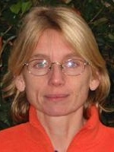
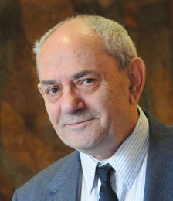

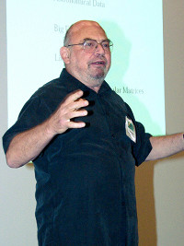
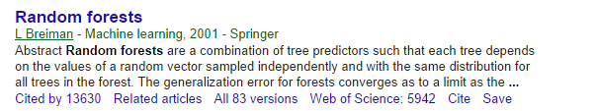
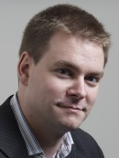

SVM vs RandomForest

Slide 3
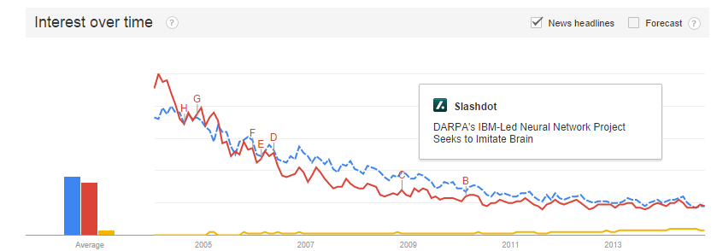
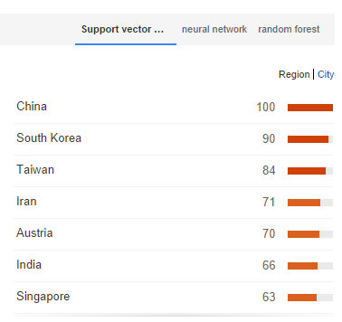
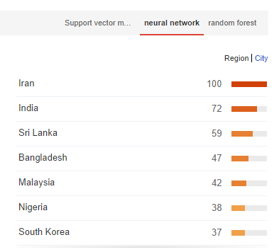
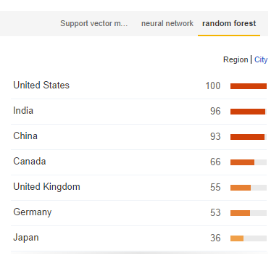
Some Statistic of statistical classifiers

Slide 4
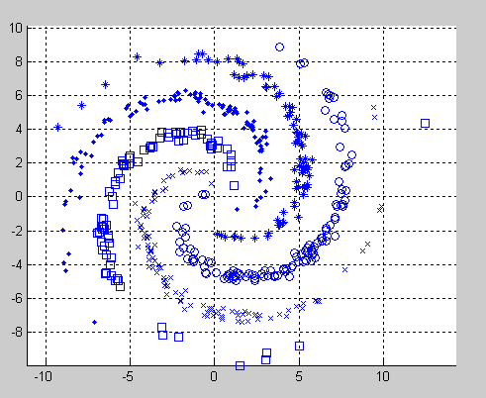
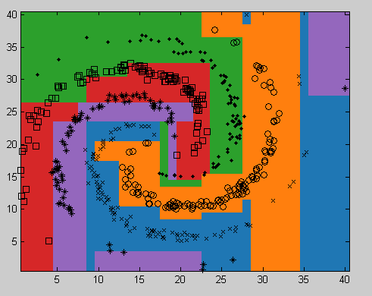
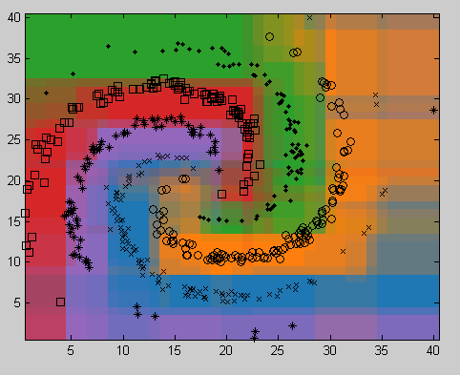
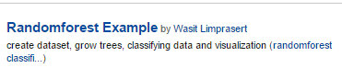
Randomforest example on MATLAB
Training data
Single tree classifier
Random Forest classifier

Slide 5
Challenges
Previous challenges | New challenges
Accuracy Studying on some small dataset and adjusting parameters to get best result | Big data Huge amount of data generated.
Small number of samples Collecting data was so expensive | Tasks distribution Incoming data larger than computation capacity of single machine to process
Over fitting problem because of spending to much time on adjusting parameters | Scalability Able to expand computational power from 10 to 10,000 machines
Limited computational power Computational power was limited. A small number of samples could be processed in a limited time. | Failure is normal Standard datacentre has 1% of AFR.
[1] https://blog.codecentric.de/en/2013/11/hardware-will-fail-just-way-expect/
[2]https://gigaom.com/2013/09/19/facebooks-data-centers-are-pioneering-open-source-hardware/

Slide 6
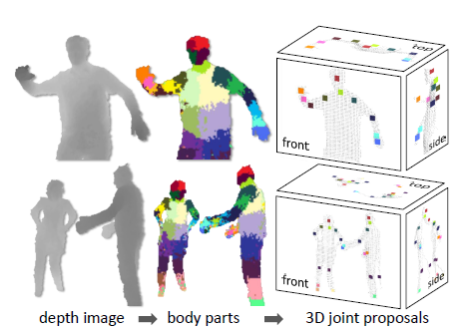
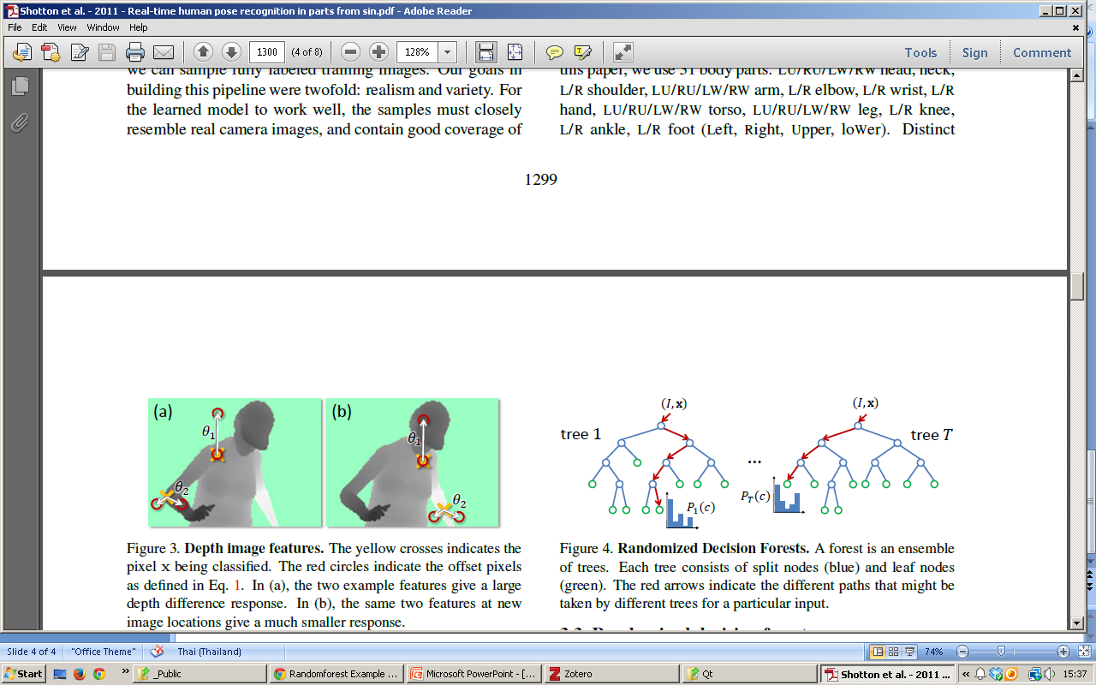
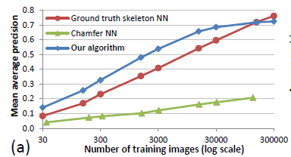
[Shotton2011] Real-Time Human Pose Recognition in Parts from Single Depth Images
A pair consists of
a depth image and
a ground-truth (label) image
took 24 hr for training with 1,000 cores system
Classifying at 200fps on Xbox

Slide 7
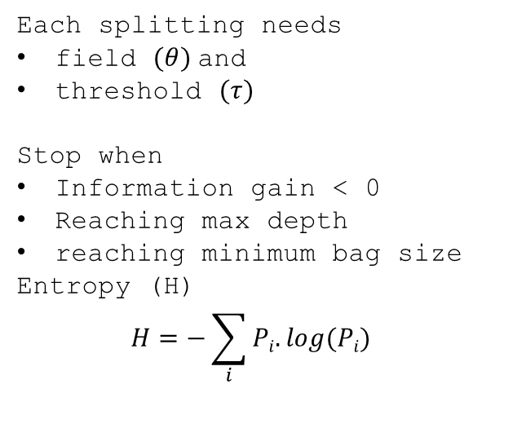
Splitting Decision tree
Histogram
OK, broken-down
Index | Weight | Mileage | User age | province | …
1 | 1.5 | 15000 | 35 | 1
2 | 1.2 | 40000 | 25 | 70
… |  |  |  |  | …
{1,3,4,7,…}
Divided by mileage at 30,000
Each splitting needs
field $(θ)$and
threshold $(τ)$
Stop when
Information gain < 0
Reaching max depth
reaching minimum bag size
Entropy (H)
$$H=−\sum_{i}{Pi.log(Pi)}$$
{1,4,…}
{3,7,…}
Divided by user age at 30
{1,…}
{4,…}

Slide 8
Init
Construct Q={x}
For i
Random splitting parameter (theta and tau)_i
calculate G(theta,tau)_i
Find G_max
Use (theta,tau)_max to split Q int QL and QR

Slide 9
Feature Space
θ₁
Histogram
OK, broken-down
θ₂

Slide 10
Feature Space
θ₁
Histogram
OK, broken-down
θ₂

Slide 11
Feature Space
θ₁
Histogram
OK, broken-down
θ₂

Slide 12
Feature Space
θ₁
Histogram
OK, broken-down
θ₂

Slide 13
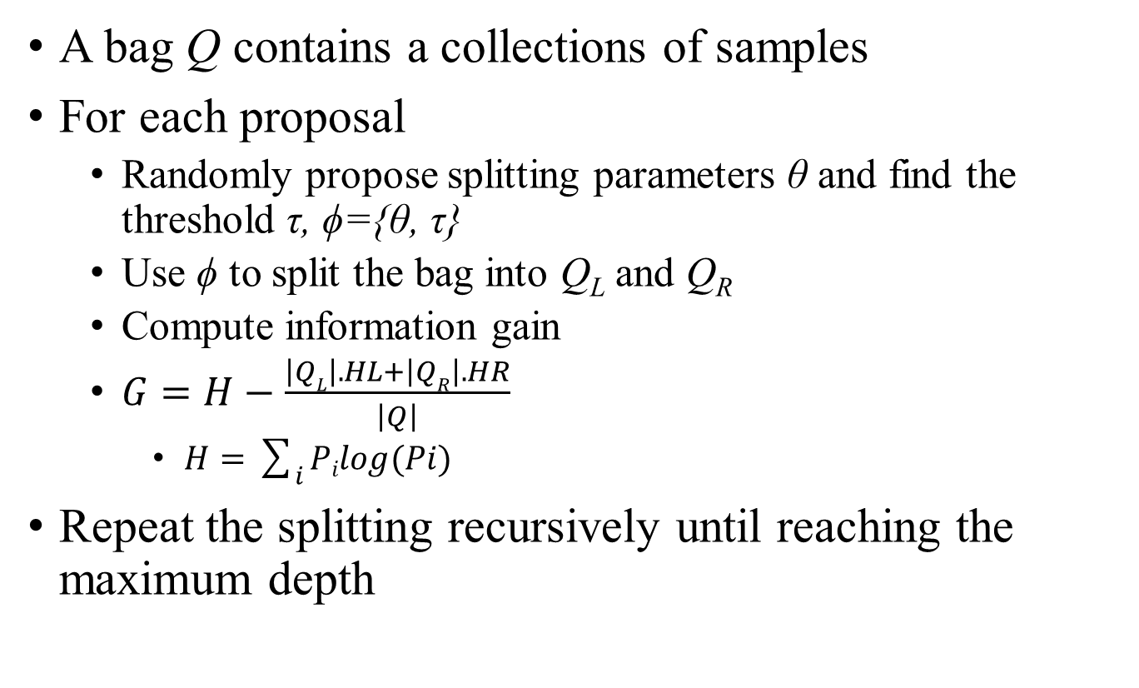
Algorithm
A bag Q contains a collections of samples
For each proposal
Randomly propose splitting parameters θ and find the threshold τ, ϕ={θ, τ}
Use ϕ to split the bag into Q_{L} and Q_{R}
Compute information gain
$G=H−\frac{\left|QL\right|.HL+\left|QR\right|.HR}{\left|Q\right|}$
$H=\sum_{i}{Pilog(Pi)}$
Repeat the splitting recursively until reaching the maximum depth

Slide 14
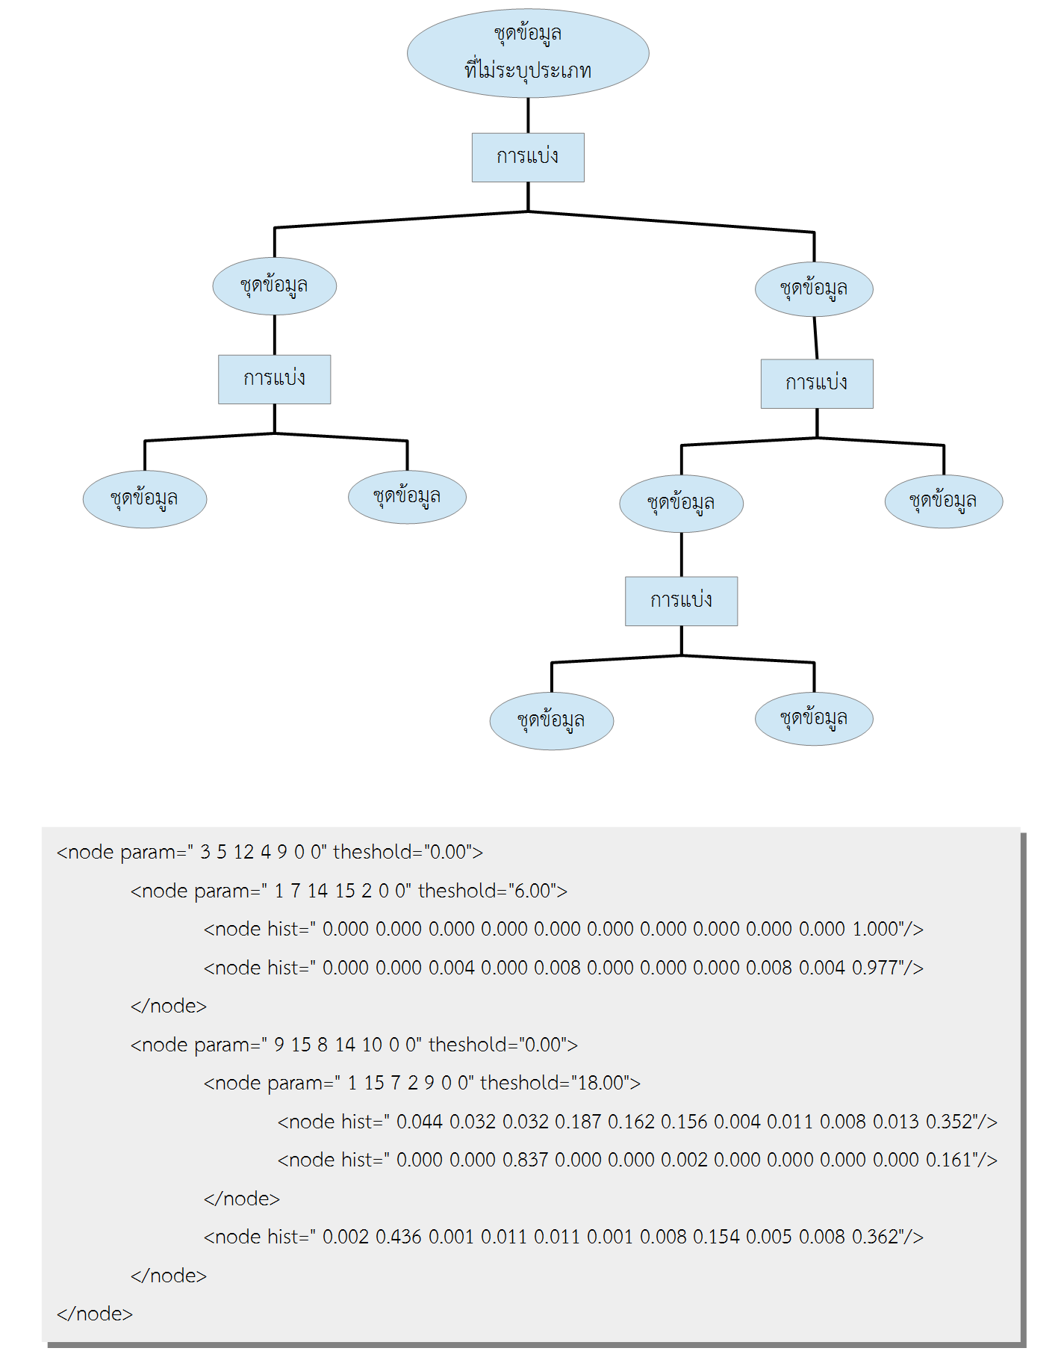
Output tree

